Slide 1
Oracle SQL
Functions

Slide 2
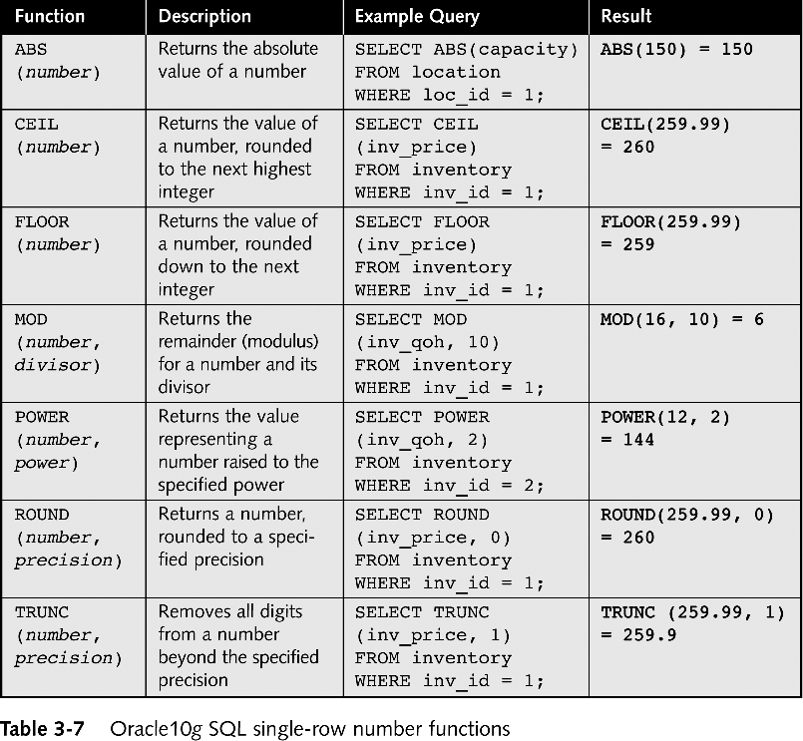
Single-row Number Functions

Slide 3
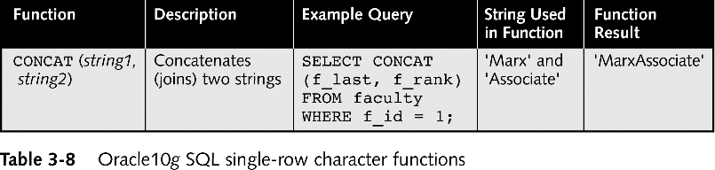
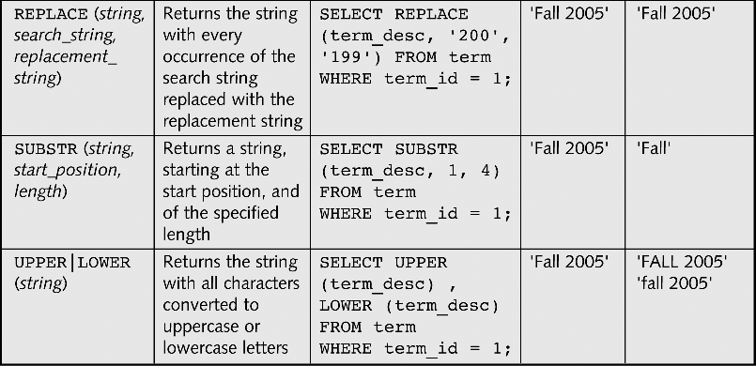
Single-row Character Functions
Continued on next slide

Slide 4
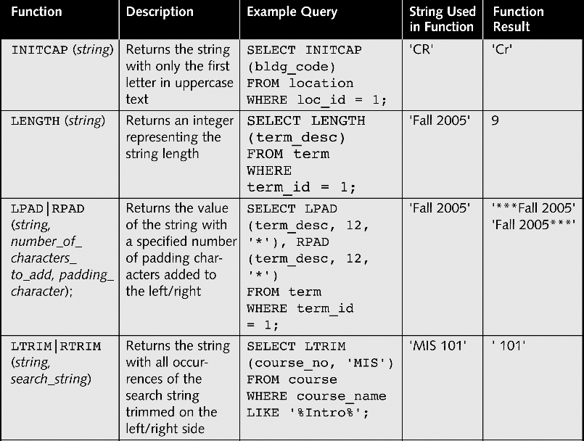
Single-row Character Functions

Slide 5
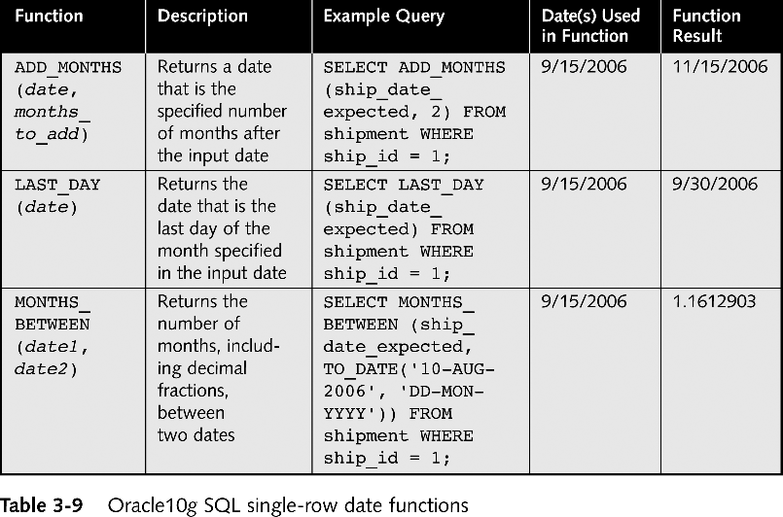
Single-row Date Functions

Slide 6
Aggregate or Group Functions
Aggregate functions return a single result row based on groups of rows, rather than on single rows.
Can’t mix aggregate results and single row results.
Aggregate functions take some type of expression. The expression is usually a column name, but it can also be a constant or calculated value.
Aggregates cannot be used as conditions in the WHERE clause.

Slide 7
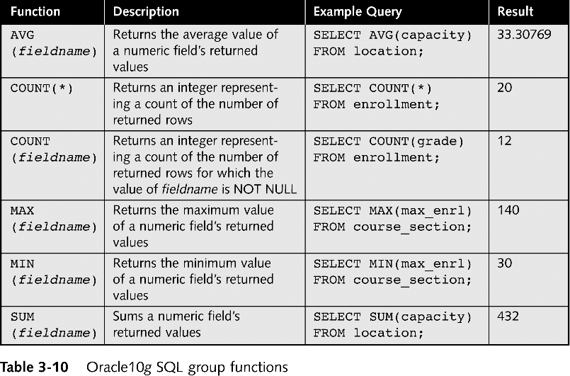
Group Functions

Slide 8
GROUP BY and HAVING clauses
GROUP BY: The GROUP BY clause is used to group rows that have the same values in a specified column or columns. This is often used with aggregate functions such as COUNT, SUM, AVG, MIN, and MAX to perform operations on each group. Here's a basic example
SELECT department, COUNT(*) as employee_count
FROM employees
GROUP BY department;

Slide 9
HAVING clauses
HAVING: The HAVING clause is used to filter the groups that are returned by the GROUP BY clause. It allows you to specify a condition for the groups rather than individual rows.
Example
SELECT department, AVG(salary) as avg_salary
FROM employees
GROUP BY department
HAVING AVG(salary) > 50000;

Slide 10
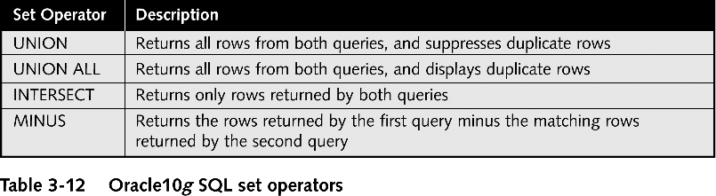
Set Operators to Combine Query Results

